Slide 1
Deep Learning Stock Market Analysis
Eric Escareno
Christian Galleisky
Irvin Budwal
Joseph Lopez

Slide 2
What are we investigating? Why is it interesting?
Market psychology paired with deep learning can give us greater insight into how and when we should make trades. This is interesting to our group as most of us have very little investing experience so if novices can figure out how to leverage deep learning effectively there are many more possibilities.

Slide 3
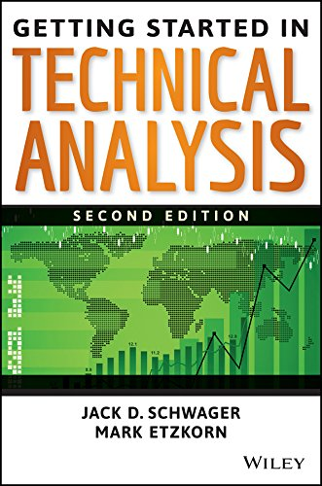
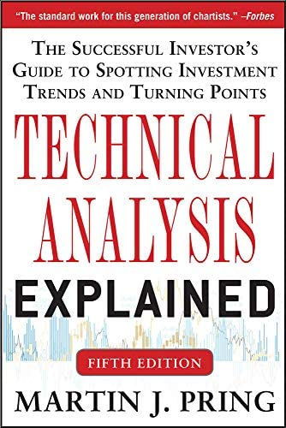
What reading will you examine to provide context and background?
Getting Started in Technical Analysis by Jack Schwager. Technical Analysis explained by Martin Pring. Both books give detail on technical analysis which can be used to make better predictions in stock price.

Slide 4
Data and Approach
Various APIs exist for trading stocks
Yahoo finance API appears to be a reliable/approachable choice (also free)
Though limited in options, may provide enough tools that we need
Alpha Vantage API also appears approachable and can code in python
May require payment for other premium features
Obtain large datasets to train our model:
https://www.kaggle.com/jacksoncrow/download-nasdaq-historical-data/notebook
We will try to get current data by either web scraping where possible or trying a script that collects the data.
https://www.kaggle.com/datasets/jacksoncrow/stock-market-dataset/discussion/188637
If we cannot find a means to quickly collect new data then we will use existing data to build upon.
Our model is meant to measure the emotional state of the market
Not just when to trade/take advantage of the market
Observe how the market feels about a certain share

Slide 5
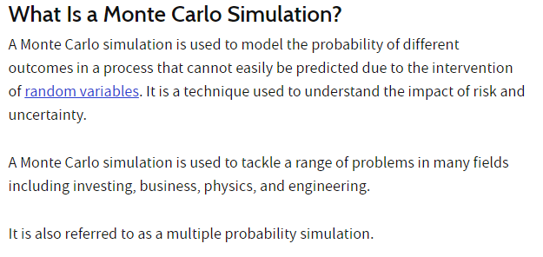
Method/Algorithm
https://www.investopedia.com/terms/m/montecarlosimulation.asp - The Monte Carlo Simulation
Notes:
https://www.kaggle.com/code/artemburenok/stock-analysis-monte-carlo-build-portfolio

Slide 6
How we build on the method? Metrics
There are existing implementations which we can build off of and tweak. Most likely this will require adding different forms of data to include as context. These can include:
Classical Economic indicators; capacity utilization, industrial production, inventories growth/contraction, unemployment rate, participation rate, savings rate, income growth rate, disposable income growth/contraction, etc…
Classical Business metrics: Price to earnings, price to earnings and growth, gross margin, operating income, Earnings before taxes interest and deductions (EBITDA), profit margin, Earnings per share, long term debt, assets, liabilities, assets minus liabilities, etc…
Classical stock chart ideas; shapes of stock price graphs and shapes of various stock chart metrics like RSI and Stochastic Oscillator, etc…

Slide 7
How will we evaluate our results?
We will evaluate our results by checking whether our model makes accurate predictions. We will need to learn technical analysis, which market psychology is an aspect of, to make our own predictions to compare against. Our results should be representable as plots and we should be able to compare the accuracy of our predictions across sample sizes to tweak our activation function. The ultimate goal would be to make the model as accurate as possible.

Slide 8
What drives market capitalization??
High quality products, new products, at the right price and right time!
Over time all products tend towards a homogenous price point. All companies sell for the same price, there is no more edge to make a profit on. Generic drugs are a perfect example of this.
Look at ETF like ‘QQQ’... Apple made up a massive majority of the shareholdings and subsequent capitalization as the price moved up.

Slide 9
Things to keep in mind while dealing with BUSINESS
Don’t chase losers into their grave. Cut your losses at small amounts and let your winners run up. Everyone makes mistakes. Move forward and head the lessons of the past.
The hope is that our market analysis model will help streamline the investment process by granting safeguards for users to maintain focus on spreads and trends.

Slide 10
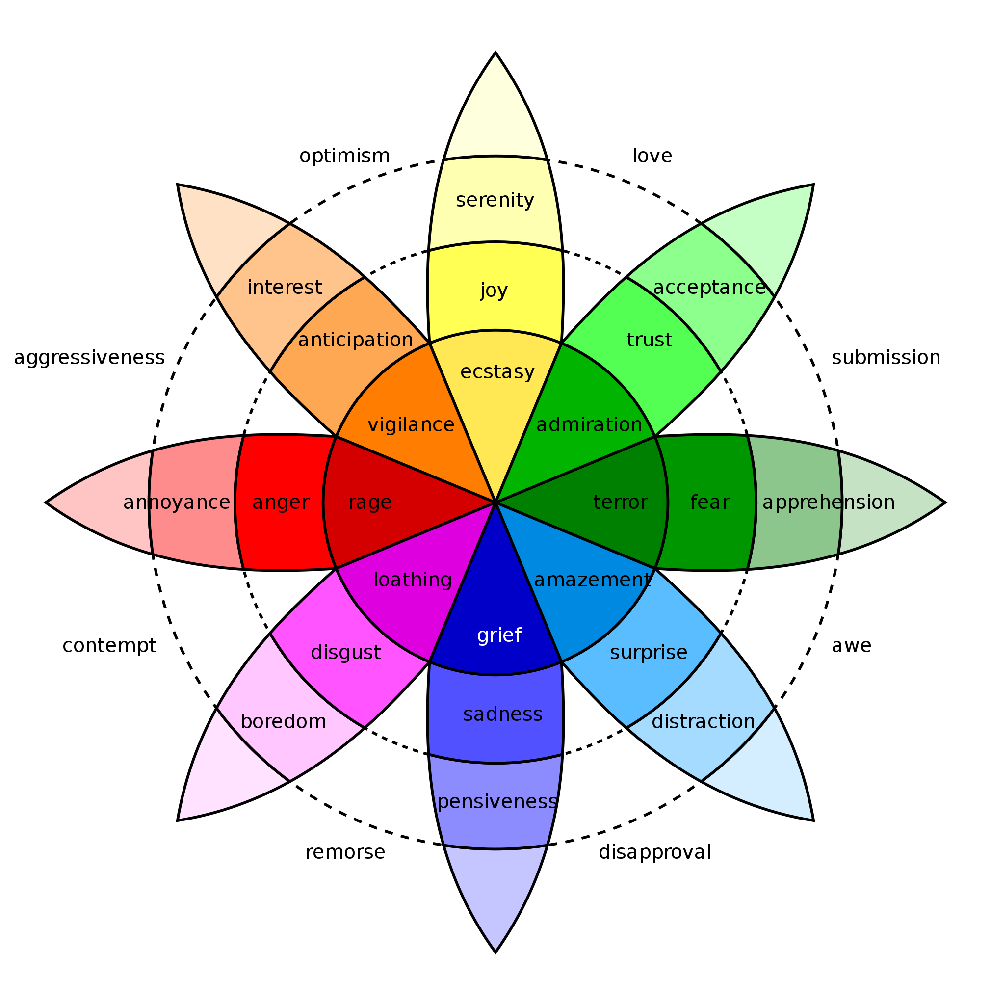

Slide 11
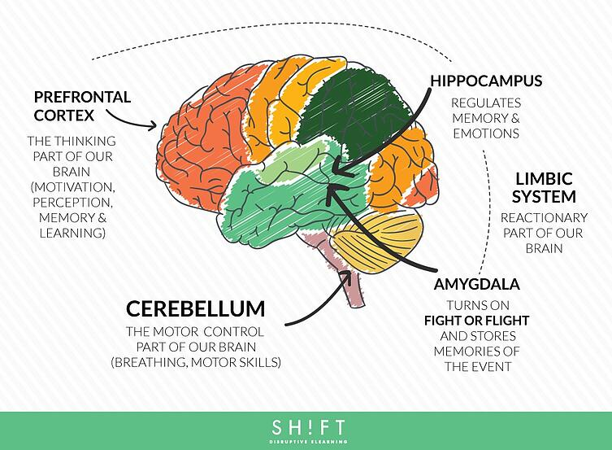

Slide 12
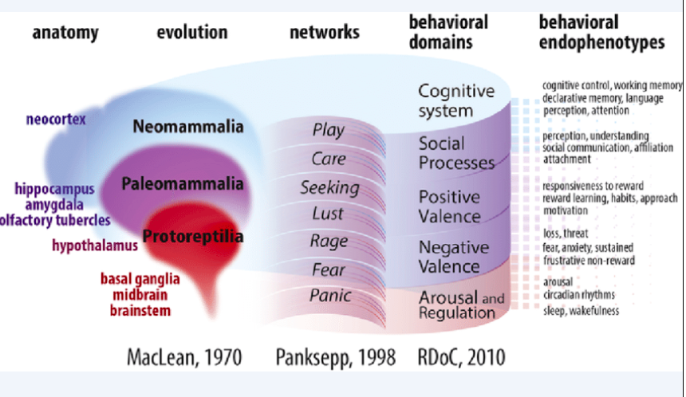

Slide 13
Any Questions?

